Slide 1
History of Bangladesh
HST 103
T. 2 Geography and Environment

Slide 2
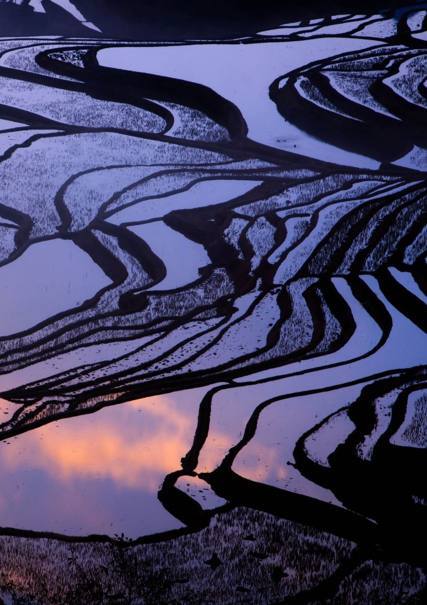
Geography
Geographically, Bangladesh is a part of the world’s largest river delta (aka Bengal Delta or Ganges-Brahmaputra Delta)
A delta is formed when rivers and their branches form a triangular shaped low and flat land mass
Plenty of water from floods, rainfall, cyclones, tidal bores etc.
The Himalayas are the most important source of land fertility – alluvial soil or silt carried by flood water coming down the mountains and emptying into the Bay of Bengal

Slide 3
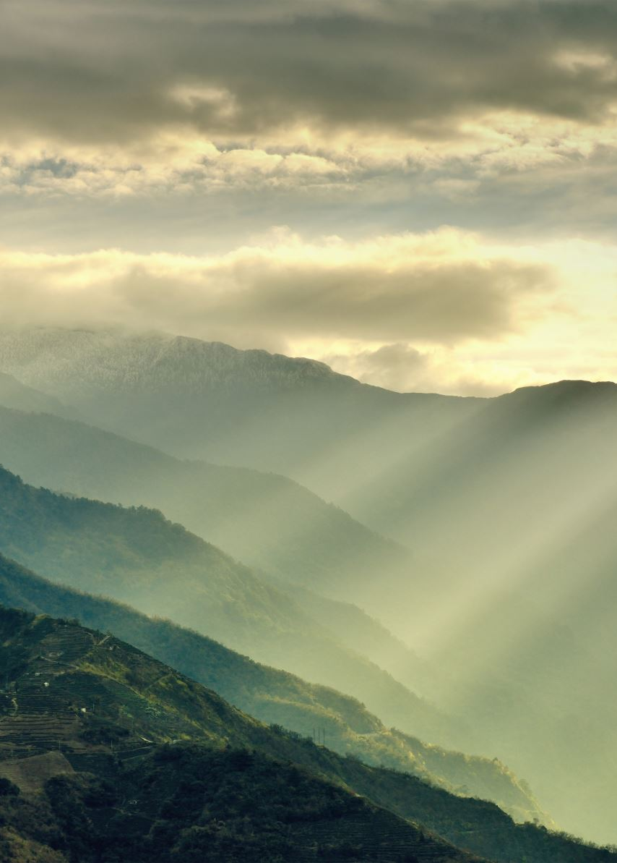
Geographical Location
Surrounded by forested highlands, the Bay of Bengal to the south, and various mountain ranges, Bengal's geographical location has influenced its cultural and historical interactions. The eastern front faces Brahmaputra and hills, while dense forests and mountains mark its western borders. The Bay of Bengal provides a natural southern frontier.

Slide 4
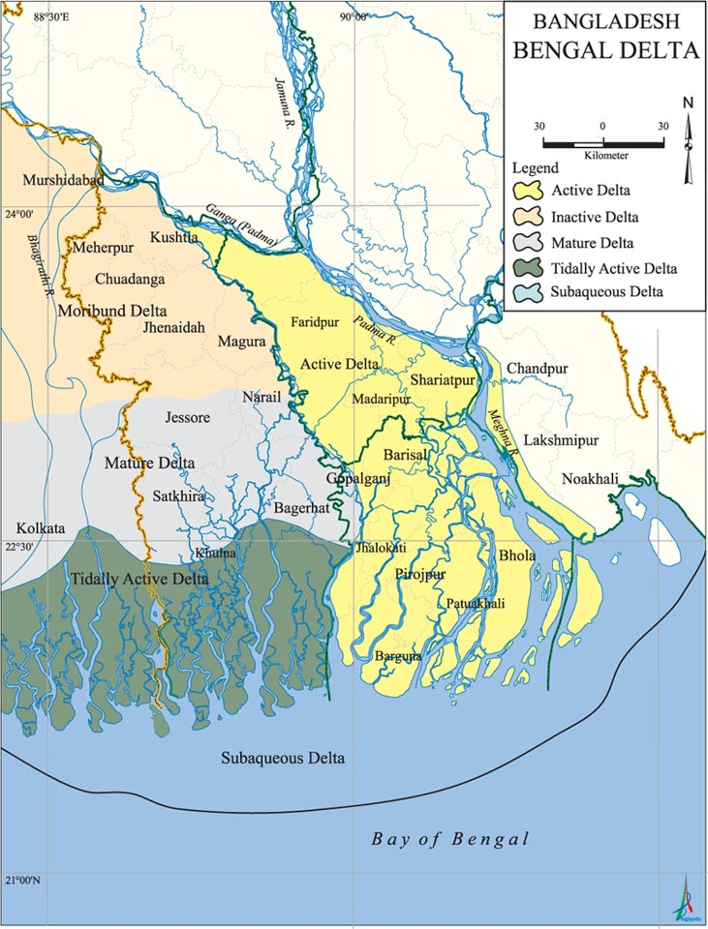

Slide 5
Impact of Geography and physical Environment
Great influence of Geographical location and physical living conditions on society, culture and all aspects of life of the people
People living in a cold, dry country and those living in a warm, humid climate have different ways of life
Even the amount of humidity in air, type of food consumed by the people dictate their lifestyle, socio-cultural norms etc
Since history is created by human thoughts and actions, their living conditions need to be carefully explored

Slide 6
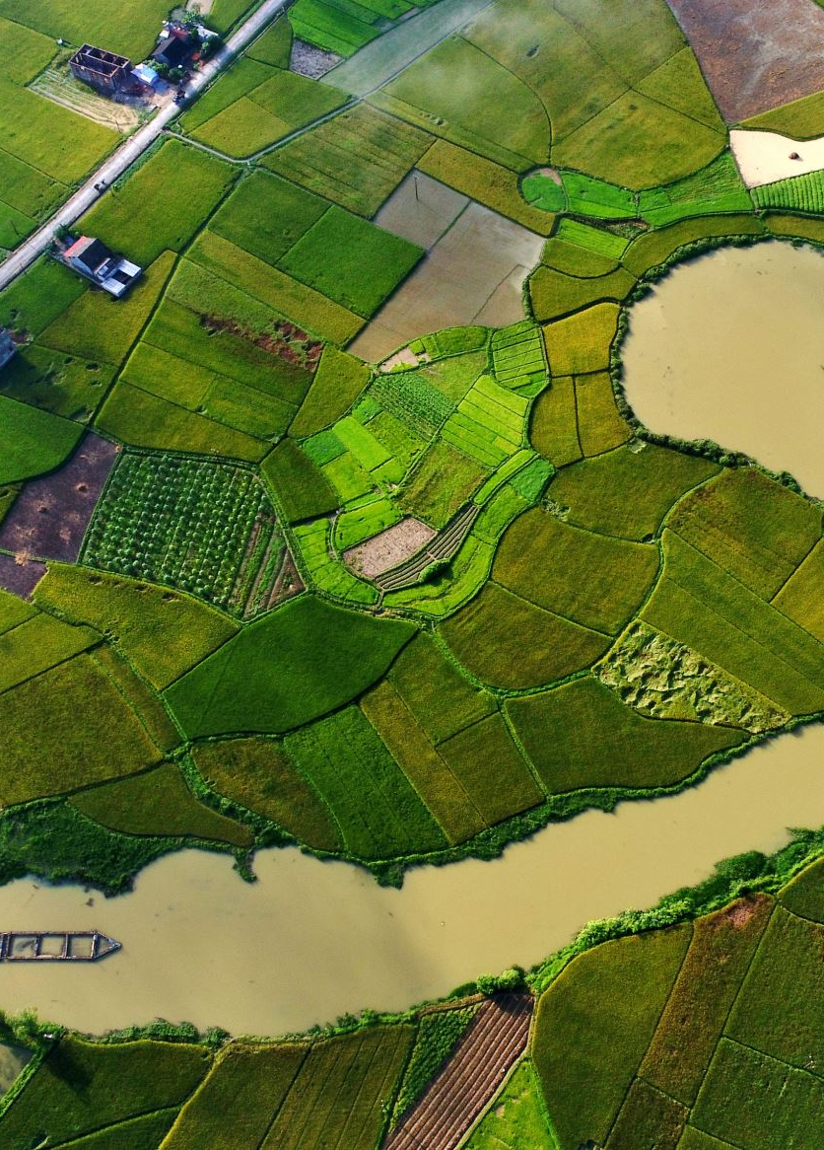
Water as the Lifeline
* Water and land fertility
Three main sources of water: rivers, monsoon rains and sea water
* Over fifty rivers flow from India and empty into the Bay of Bengal - on the way, they prepare the land for cultivation of rice
Three main rivers: Padma, Jamuna (Brahmaputra) and Meghna)
The rivers carry silt that increases land fertility

Slide 7
Second & Third sources of water
Around late May or early June – clouds above the Bay of Bengal result in torrential monsoon rains (thanks to the Himalayas) – continue till September
The reins provide moisture for the land, which is good for harvest
Rains also cool down the temperature, though causes suffering for the people and crops as well
Finally, saline water from the Bay of Bengal penetrates inland due to tidal bores from tropical cyclones from October to May – the lower delta being very flat (less than three meters above sea level) – this sometimes result in colossal natural disasters

Slide 8
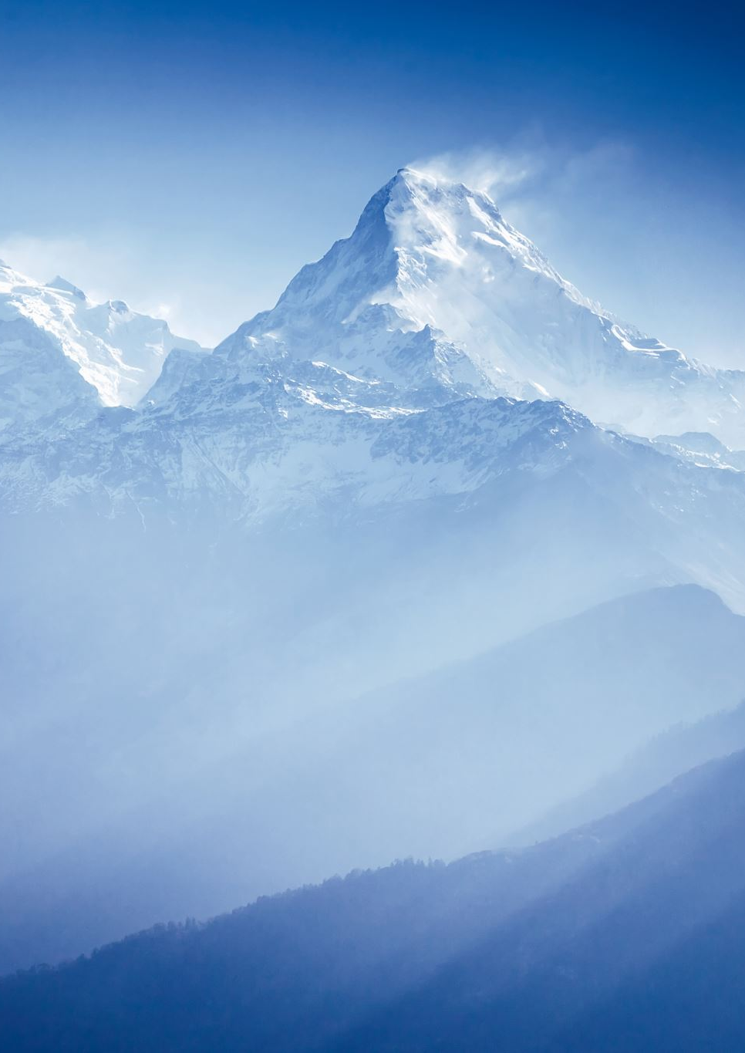
Himalayas – our ‘guardian angel’!
Great role played by the mountain range of Himalayas in shaping the society, culture and state of Bangladesh
It blocks the monsoon winds blowing from Arabian Sea and the Bay of Bengal, forcing them to release moisture in the form of snow and rain across India and Bangladesh
It also prevents East Asian winter storms from entering our country, protecting us from extreme cold
It acts as the source of our great rivers like Padma, Jamuna (Brahmaputra) Meghna and many others
The rivers carry silt, which increases our land fertility
Thanks to such abundant water supply, there was no need for elaborate irrigation (hydraulic) system, also no need for a strong tyrannical regime like Mesopotamia or Egypt

Slide 9
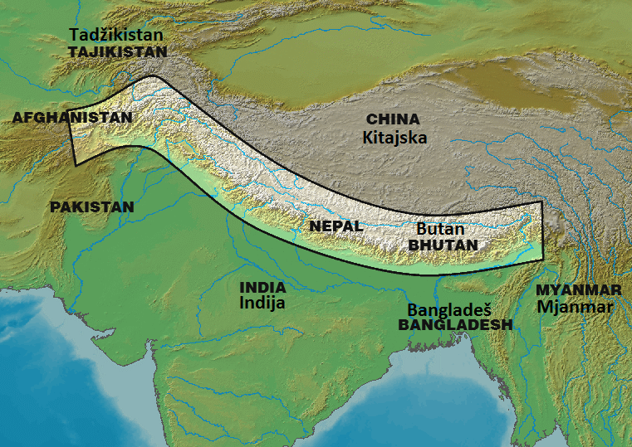

Slide 10
The Sundarbans
The largest mangrove forest (about 6,000 sq.km.)in the world – located in the South-West of Bangladesh, where Ganges-Brahmaputra merge with the Bay of Bengal
A number of globally important and endangered species including Royal Bengal Tiger, Dolphins, Crocodiles, birds etc inhabit here
Sundarbans is the ‘silent protector’ of Bangladesh – acts as a shield against natural disasters like cyclone and tidal surge

Slide 11
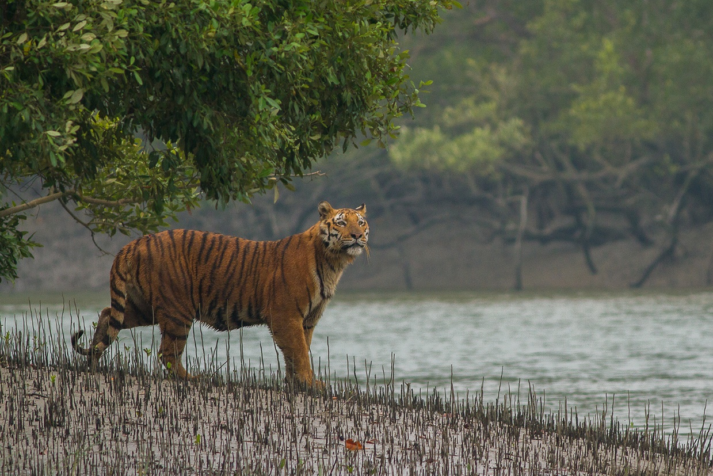
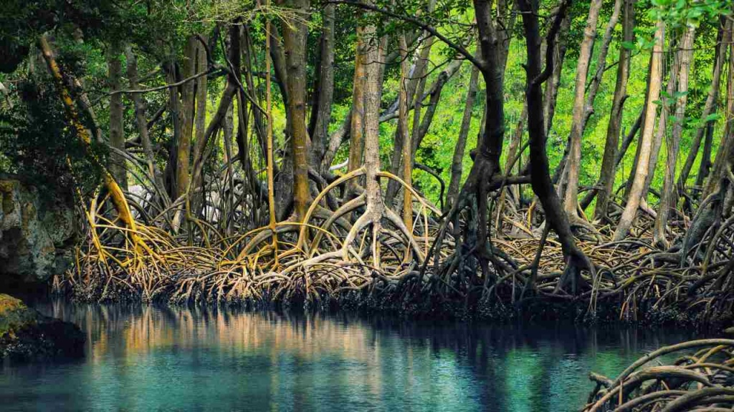
The Sundarbans
Royal Bengal Tiger
Mangrove Forest

